Slide 1

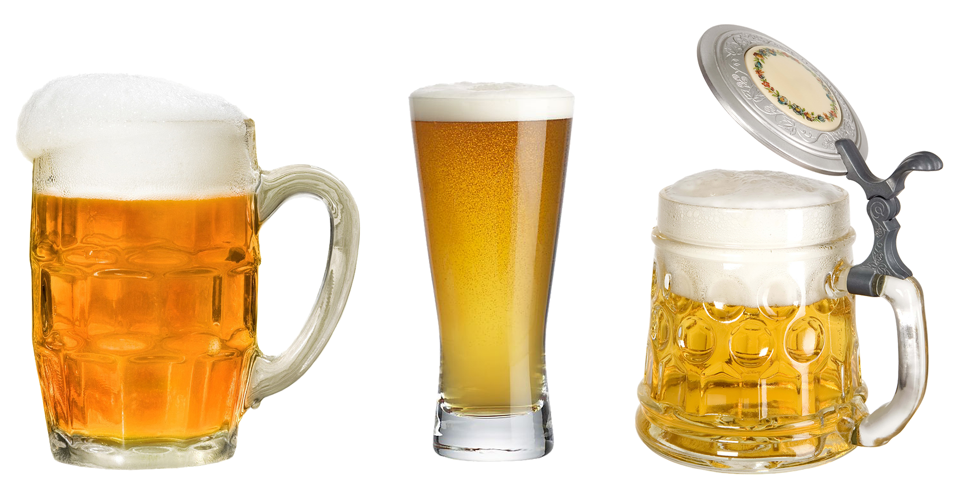
Project McNulty: Identifying craft beer style
Natalia Lichagina
Feb 13th, 2019

Slide 2
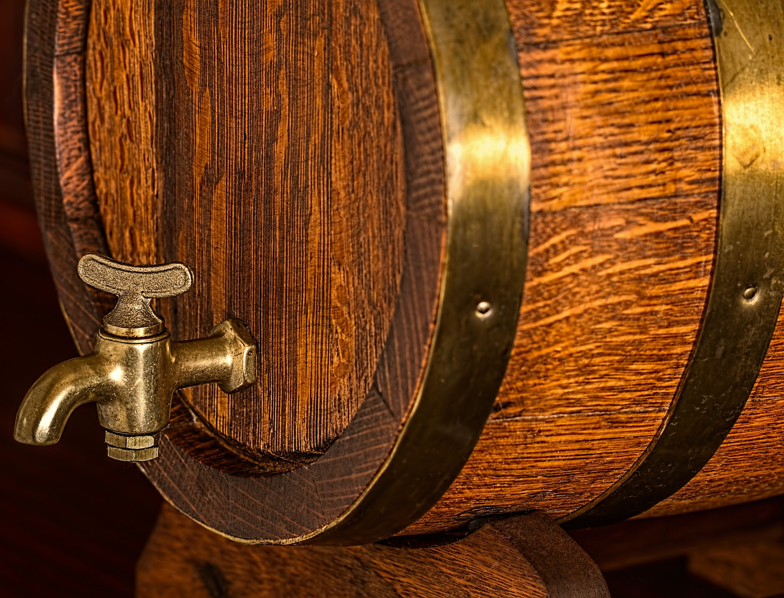
1978: Federal Law passed allowing any adult to produce wine and beer for personal and family use
“Up until the early-1980s the popular image of beer in America was simply that of a mass-produced commodity with little or no character, tradition or culture.” - Brewers Association, History of Craft Brewing
Notes:
Source: https://www.brewersassociation.org/brewers-association/history/history-of-craft-brewing/, Wikipedia
On October 14, 1978, H.R. 1337 was signed into law, which legalized the home production of a small amount of beer or wine for personal consumption.

Slide 3
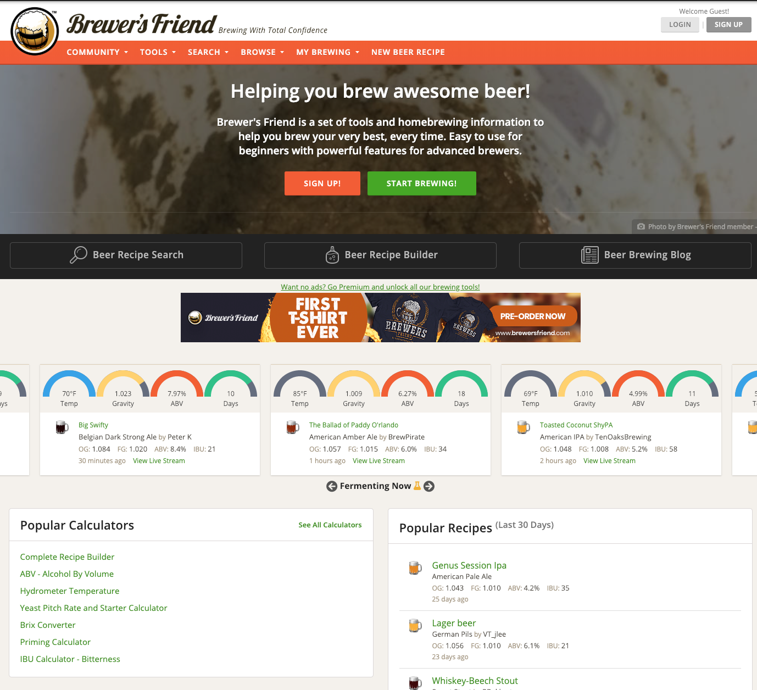
Homebrewing is now a huge hobby!
My dataset (Kaggle):
74K user-reported recipes
spanning 176 beer styles

Slide 4
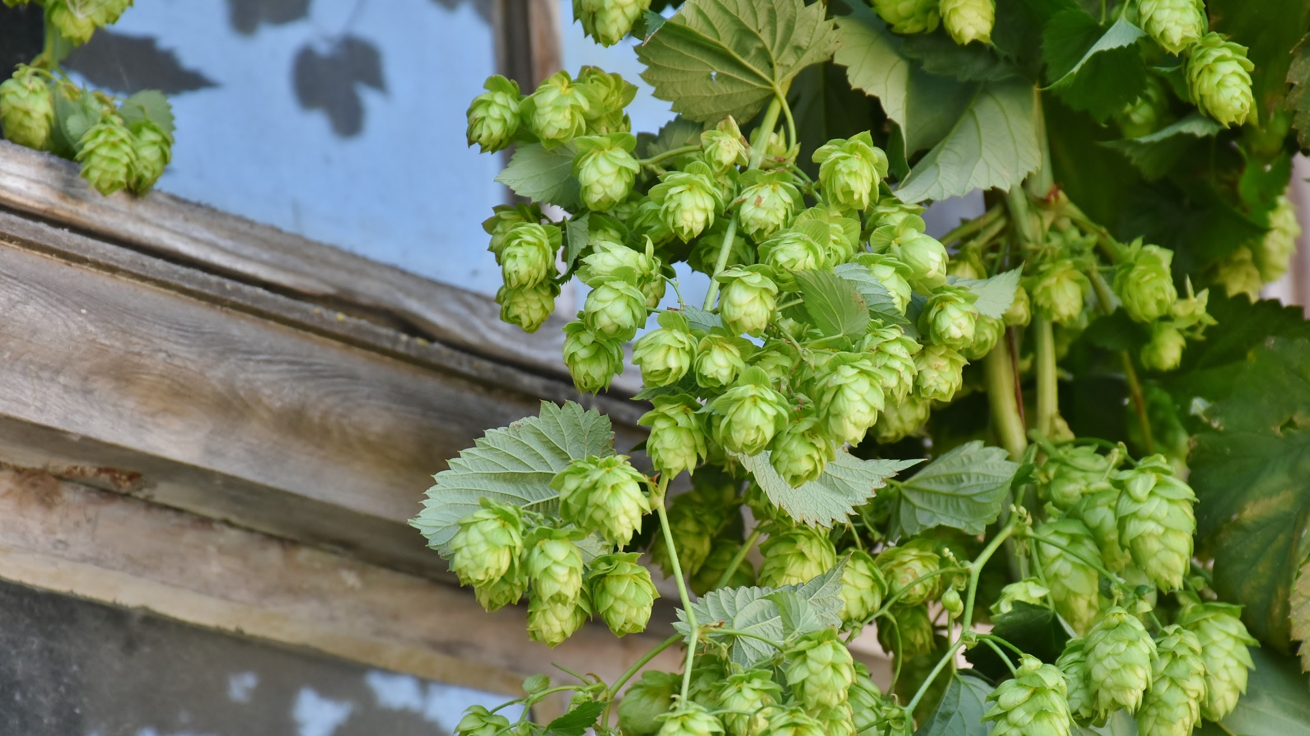
Key terms:
ABV: Alcohol by Volume
IBU: International Bitterness Units
SRM: Standard Reference Method (color scale)

Slide 5
176 styles -> 8 final style groups

Slide 6
Some styles are easier to identify than others
Model predictions as % of all records in a style group
(each row sums to 100%)
Overall accuracy = 80%

